Slide 1
Spring MVC

Slide 2
Agenda
Introduction to Spring framework
Introduction to containers managing beans
Dependency Injection and its ways
Bean Lifecycle
Auto wiring beans
Configuration based on Annotation
Integrating database

Slide 3
Introduction to Web Applications
Any application that is accessible over the web using Internet
Examples:
Amazon.com, flipkart.com, bookmyshow.com, cricbuzz.com etc.
The users can enter the website and start accessing the applications
The Web application is composed of many pages, each serves represents separate functionality
Every web application starts with the first page called Home page

Slide 4
3 Layers in web applications
In Web applications, the entire code is divided into the following 3 major layers
UI Layer
Receives the users input and sends to the server
Middleware Layer / Business Logic Layer
Business Logic / Data processing is done
Data Layer
Data is stored in Database servers such as ORACLE, SQL SERVER etc.

Slide 5
Introducing MVC
MVC – Stands for Model View Controller
Model has all the data required for the application
View has all the UI to show to the end users
Controller controls all the activities of the application

Slide 6
MVC in Java based web applications
In Java Based web applications:
Model – You can represent data and data manipulation logic (Ranges from Java method to calculate something to store the data in DB servers such as ORACLE)
View – JSP (Java Server Pages) – to generate the views dynamically based on users’ requests (Example: Showing only DELL laptops)
Controller – Java Servlets – Special Java program that intercepts users requests and forwards to particular program based on the request (Example: Calling the program that saves the users data into DataBase servers in case of user registration)

Slide 7
Issues with servlets
We need to write all controller code
Check the request and forward to appropriate web resource
Lots of if conditions (boiler-plate, plumbing code)
Examples:
If Login, invoke ValidateServlet
If Success, invoke Success.jsp
If Failure, invoke Failure.jsp

Slide 8
How Web Frameworks can help?
We don’t need to write all controller code ourselves
The framework provides a central controller class
All the requests will go to controller class first
The controller will check the request
Based on the request, user will be forwarded to appropriate page.
Web Frameworks maintain an .xml file for this purpose
In this .xml file, we can map the request and the pages to be forwarded

Slide 9
Web Frameworks - Examples
Struts
Turbine
WebWork
Cocoon
Spring MVC
Maverick
Echo
SOFIA
Jaffa
Japple
JSF – MyFaces
Wicket

Slide 10
What is Spring MVC?
Web Framework
It provides Model – View – Controller architecture
Model – POJO (application data)
View – Presenting the data
Controller – processing user request, building appropriate model and passing it to view for rendering

Slide 11
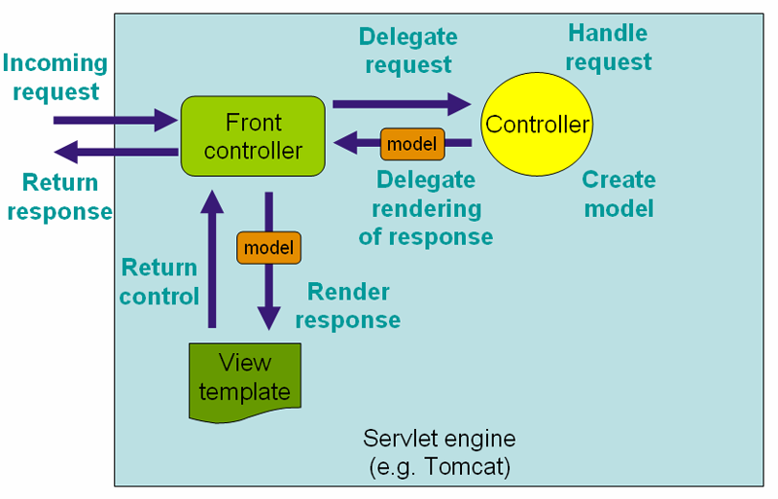

Slide 12
DispatcherServlet
In Spring MVC, DispatcherServlet is the heart.
It handles all the HTTP requests and responses
It follows Front Controller design pattern

Slide 13
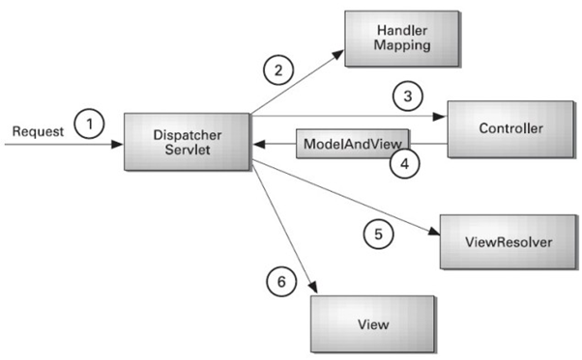
The flow

Slide 14
Explaining the flow
Client sends an HTTP request
DispatcherServlet consults the HandlerMapping and calls the appropriate Controller.
The Controller takes the request and calls the appropriate service methods based on used GET or POST method. The service method will set model data based on defined business logic and returns view name to the DispatcherServlet.
The DispatcherServlet will take help from ViewResolver to pickup the defined view for the request.
Once view is finalized, The DispatcherServlet passes the model data to the view which is finally rendered on the browser.

Slide 15
Demo Spring Web MVC

Slide 16
Thank you
Notes:
Write two or more controller classes and demonstrate
- a normal “hello MVC”
- accepting input from user from UI and connecting to DB
- If possible demonstrate accepting object an and DB integration using form submission

